Slide 1
BANKING APPLICATION
Shuaib Hussain
Notes:
Your Name
Here to pitch Himalayas
Our firm’s slogan

Slide 2
Contents
Program Overview
Project
Demonstration
Further Improvements
Notes:
The central idea

Slide 3








Program Overview
WEEK 6
POWERSHELL
LINUX
GOOGLE CLOUD PLATFORM
FLASK
WEEK 7
DOCKER
ASANA
NGINX
DOCKER COMPOSE
Notes:
The central idea

Slide 4


Program Overview
WEEK 8
DOCKER SWARM
ANSIBLE
Notes:
The central idea

Slide 5
Project Overview
Introduction
Asana
User Stories
ERD
Risk Assessment
Tests Log
CI Pipeline
Services Architecture
Ansible Playbook
Notes:
The central idea

Slide 6

Project - Bank Application
A banking web application that can generate an account number, CVC, card number and IBAN
Notes:
The central idea

Slide 7
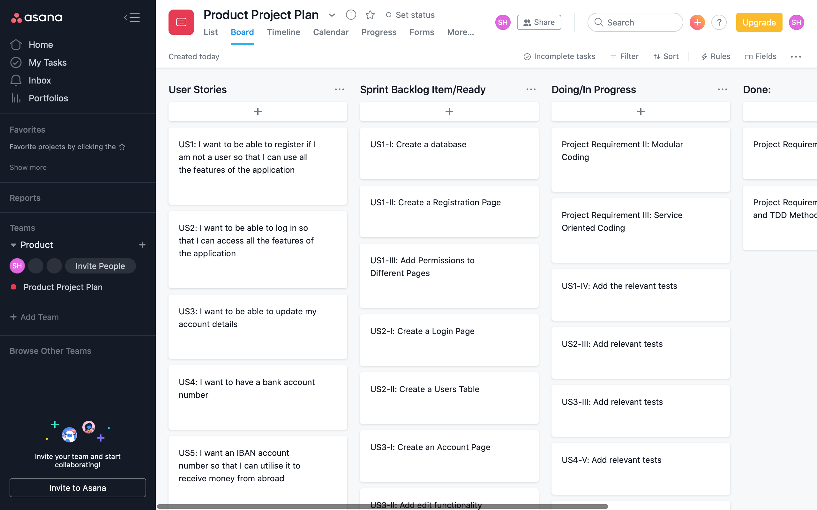

Slide 8
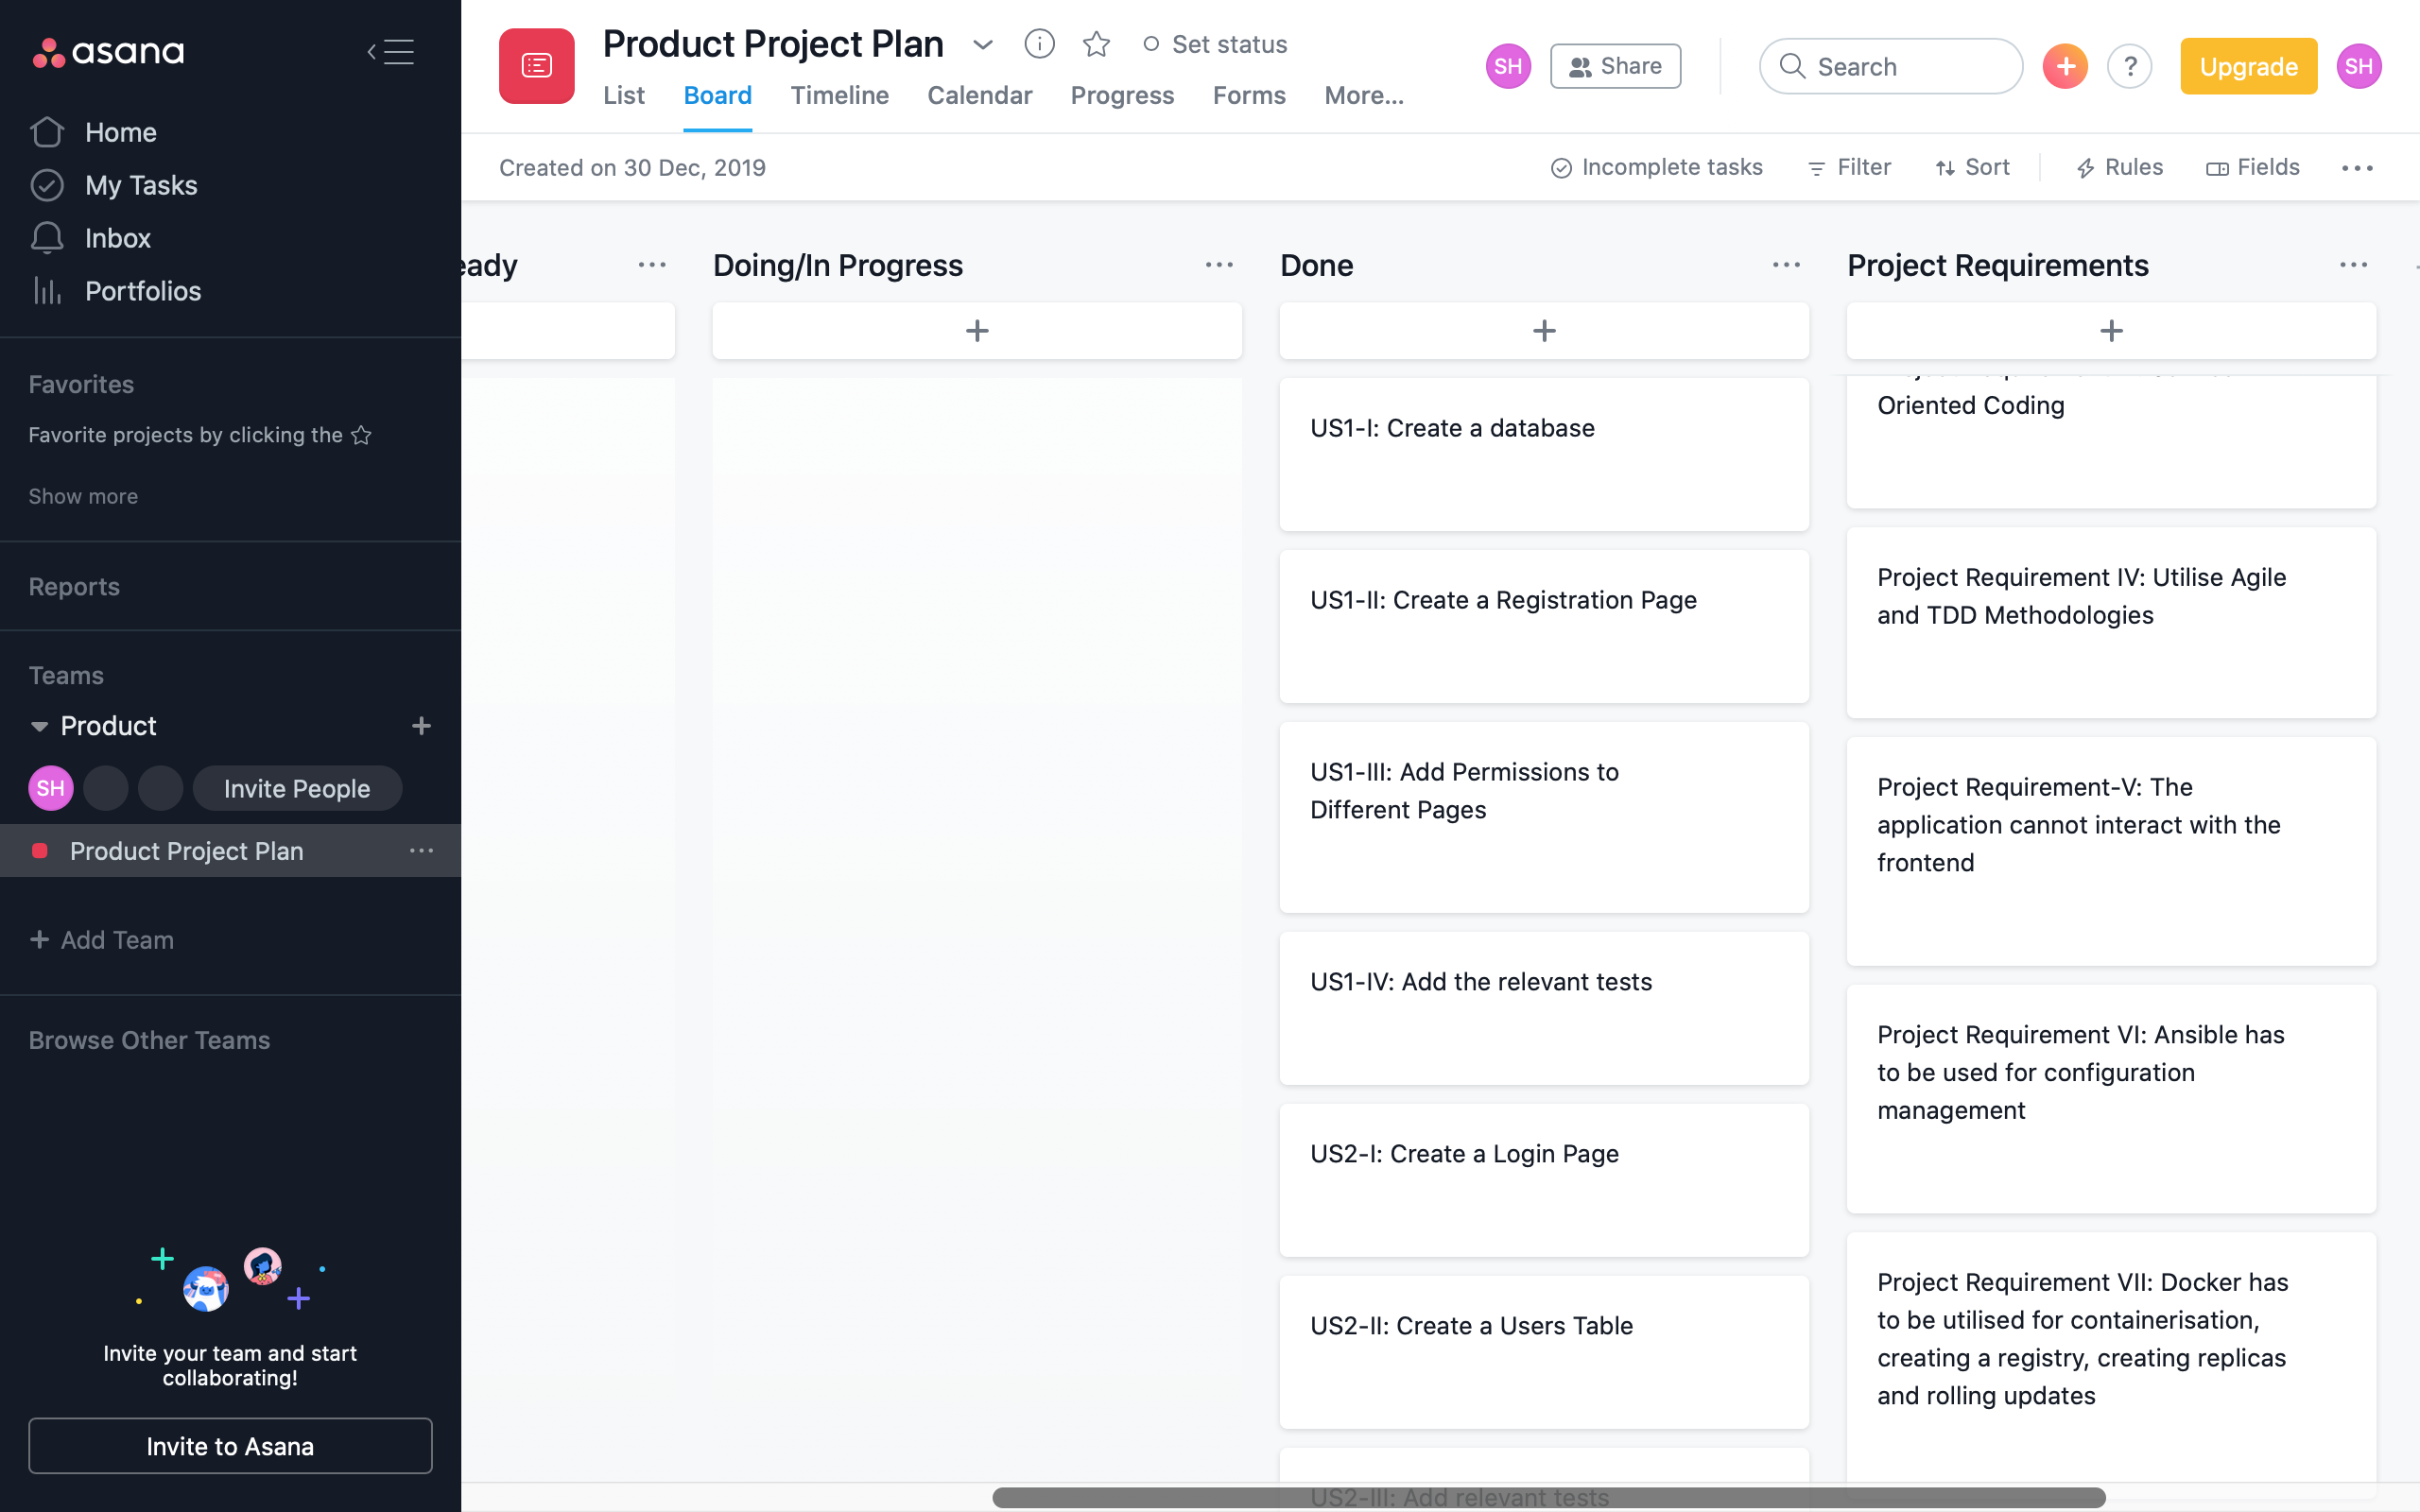

Slide 9
Create a Banking Application with a Services Architecture
Create an Application that Generates a Bank Account
I want to get an Account
I want to be able to get an Account so that I can make national and international transactions

Slide 10
Epic I: User Story and Use Case I
I want to be able to get an Account number & IBAN so that I can make transactions
User visits the website
Go to the website
Navigates to the Generator section after logging in
Select the Generator section
User presses the Generate Button
Press the Generation Button
User is satisfied with the ease of use
Notes:
The central idea

Slide 11
Entity Relationship Diagram
Notes:
The central idea

Slide 12
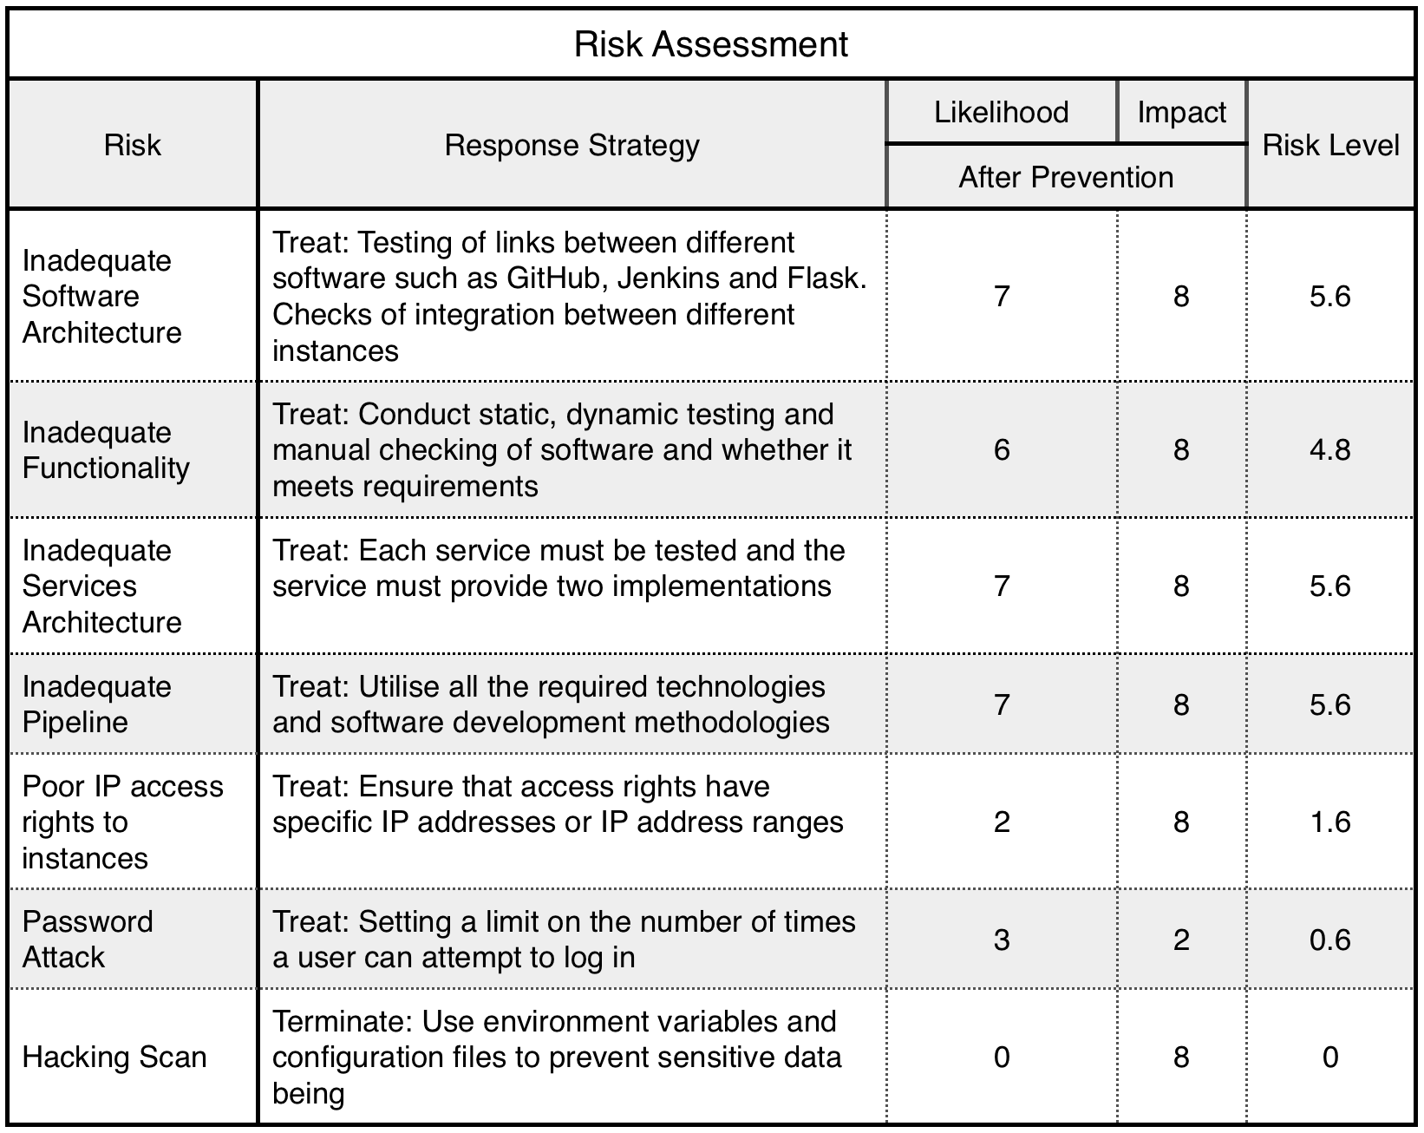
Risk Assessment
Notes:
The central idea

Slide 13
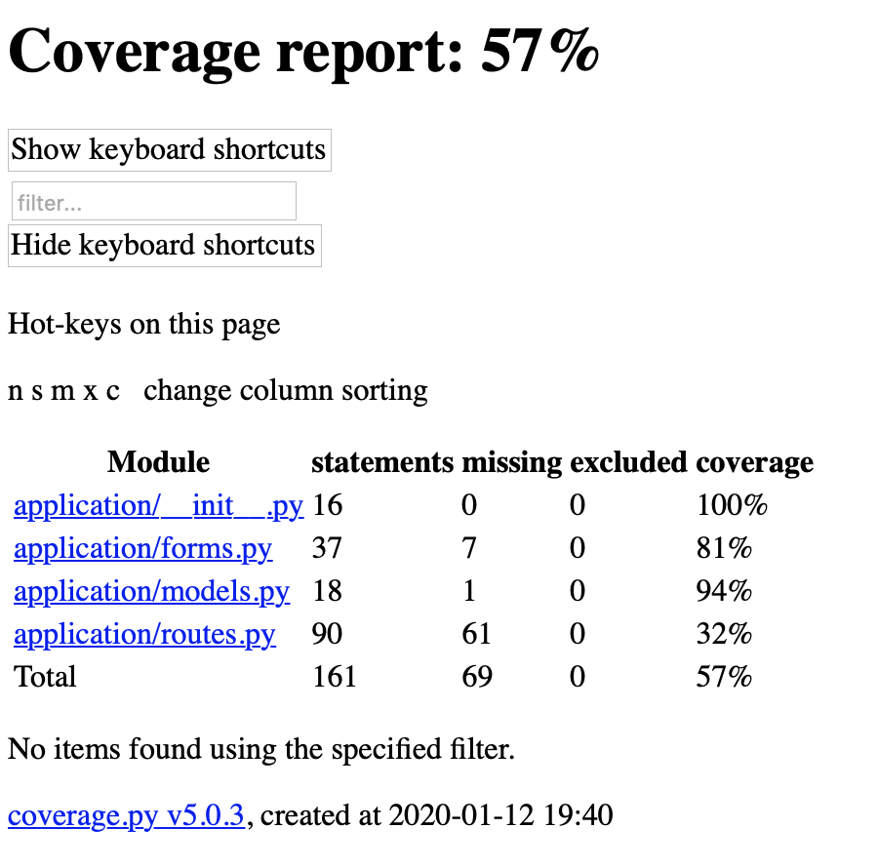
Test Log
Notes:
The central idea

Slide 14
CI Pipeline
Local Source Code
VCS
Git
PM TOOL
Asana
ARTIFACT REPOSITORY
Docker Registry
CI SERVER
Jenkins
DEPLOYMENT SERVER
Application Instance
DATABASE
SQL Instance
Testing Environment
Production Environment
Live Environment
Notes:
The central idea

Slide 15

Services Architecture
SQL Database
Front End
Central Server
Sort Code
Card Number
IBAN Preamble
Account
CVC
Notes:
The central idea

Slide 16
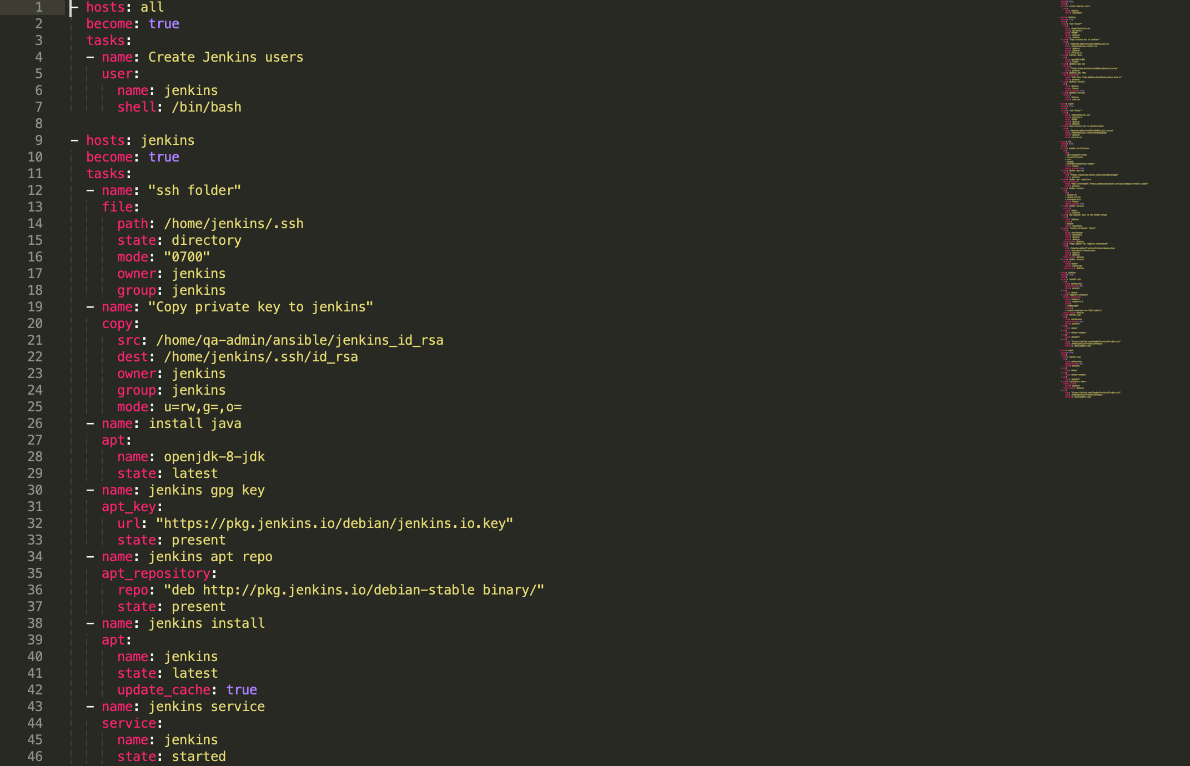
Ansible
Notes:
The central idea

Slide 17
Demonstration – Rolling Update
Web Application
http://34.77.225.138
Continuous Deployment
http://35.189.235.240:8080/job/pipeline/
GitHub Repository
https://github.com/Shaybs/PracticalProject/blob/development-test/CentralServer/application/routes.py
Notes:
The central idea

Slide 18
Future Improvements
Add transaction ability
Make a full banking application
More tests – Including tests after log in
More security – Dummy data
IAM Policies
Notes:
The central idea

Slide 19
Thank You ☺
Notes:
The central idea

